Slide 1


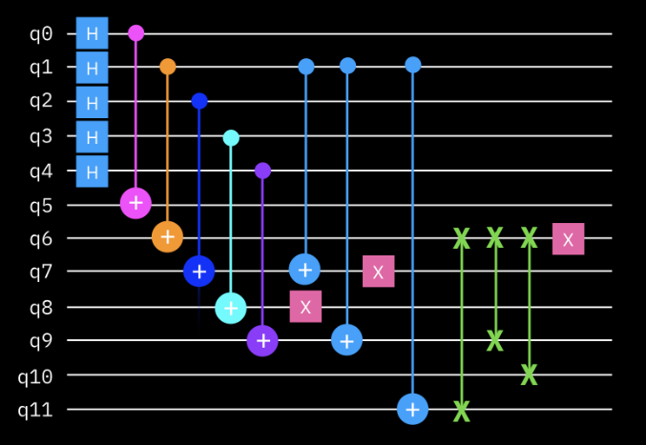
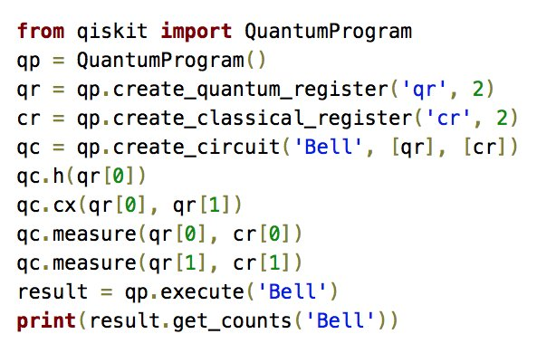
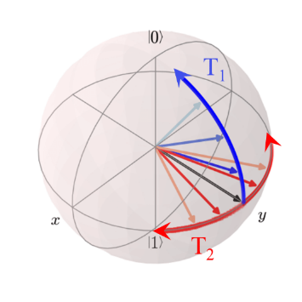

Foundations of
Quantum Information Science (QIS 102)
Dave Biersach
Brookhaven National Laboratory
dbiersach@bnl.gov
Session 02
Installing the Courseware

Slide 2
Preparing for the QIS102
During this course, you will be writing software using Python running IBM Qiskit inside Jupyter Lab Notebooks that themselves run inside Visual Studio Code
To properly set up a local Python development environment on your personal computer, we will use free & open-source tools like Git and Miniconda
If you have already installed these applications on your own computer, you may not need to reinstall them, but please ensure you are running the most up-to-date versions of these applications
Note: If you already have the full Anaconda distribution on your computer, you might not need to install Miniconda

Slide 3
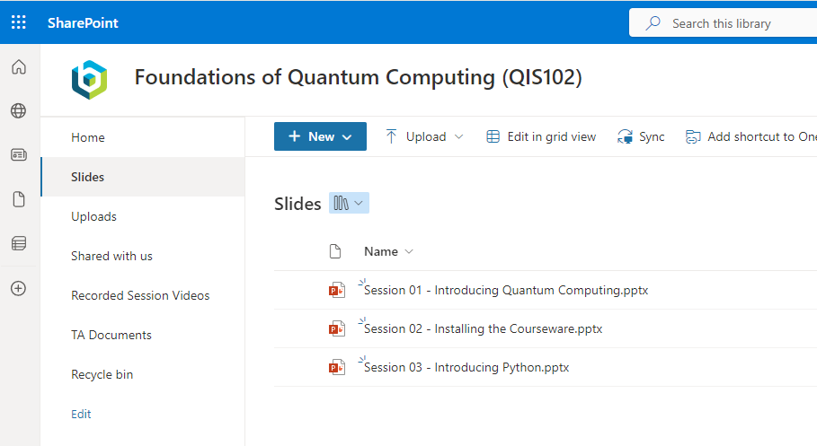
Downloading the Slides
Note: This slide deck be manually downloaded from https://brookhavenlab.sharepoint.com/sites/QIS102/Slides

Slide 4
Installing the QIS102 Courseware
If running Microsoft Windows, go to slide #5
If running Apple macOS, go to slide # 19
If running Debian Linux, go to slide # 33
Don’t forget to complete Task 02-01 (see final slide)
Note: Your output may not look exactly like the following screen shots

Slide 5
Microsoft Windows – Phase 1
You must be running 64-bit Windows 10 (or later) with an Intel CPU and a minimum of 10GB of free disk space - you will need local administrator rights on your machine
Step 1 – Install the latest (non-preview) PowerShell 7 (or later) version using its associated PowerShell-#.#.#-win-x64.msi file (in the Assets section) at https://github.com/PowerShell/PowerShell/releases
Step 2 - Run the Standalone Installer 64-bit Git for Windows Setup at https://git-scm.com/download/win
Step 3 – Install the latest Miniconda3 Windows (64-bit) at https://repo.anaconda.com/miniconda/Miniconda3-latest-Windows-x86_64.exe

Slide 6
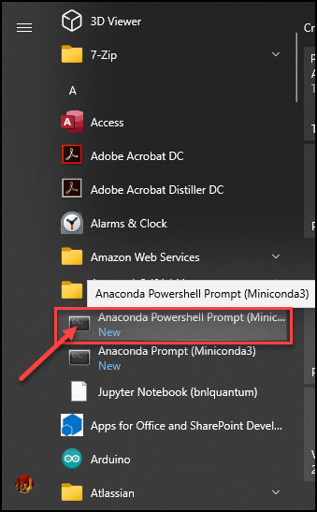
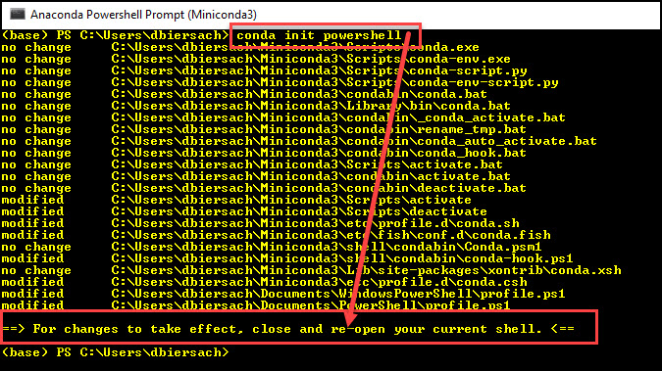
Microsoft Windows – Phase 1
Step 4 - Launch an Anaconda PowerShell Prompt:
Step 5 – Enter the command
conda init powershell
Step 6 – Close this PowerShell window

Slide 7
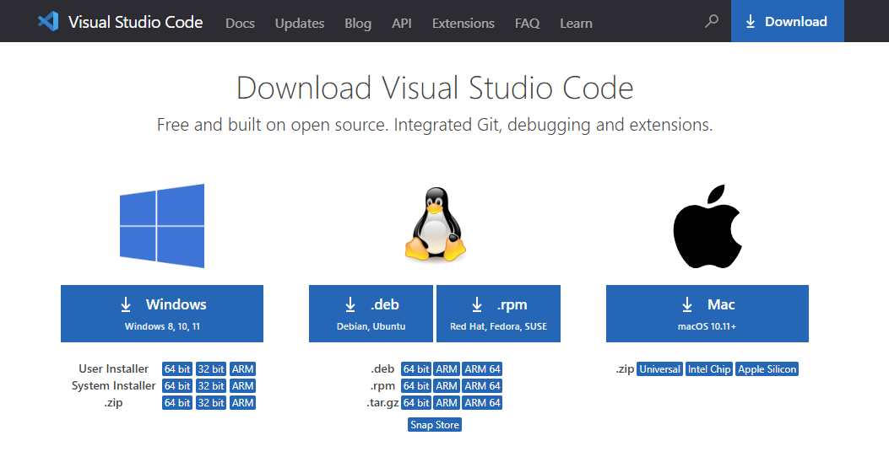
Microsoft Windows – Phase 1
Step 7 – Install the Windows 64-bit System Installer version for VS Code from https://code.visualstudio.com/Download

Slide 8
Microsoft Windows – Phase 2
After Phase 1 is complete, start a new PowerShell session and then execute these five commands (one line at a time):
Set-ExecutionPolicy RemoteSigned -Scope CurrentUser
cd $HOME
git clone https://github.com/dbiersach/qis102
cd $HOME/qis102/installers
. .\qis102-installer-windows.ps1
This step might take 30 minutes to complete!
dot
dot
space
See the next page for a screenshot!

Slide 9
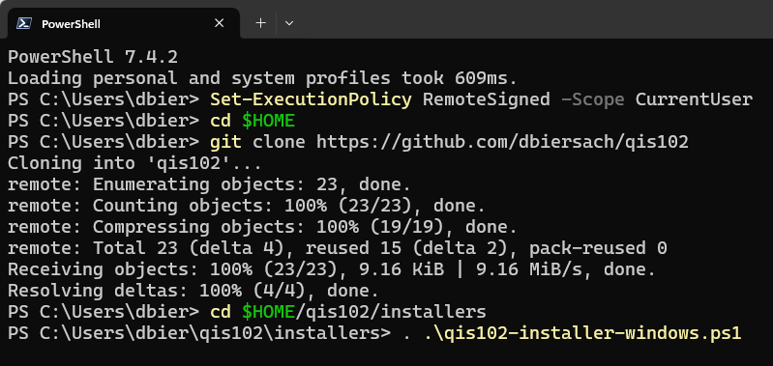
Microsoft Windows – Phase 2
Your screen might not look exactly like this
①
②
③
④
⑤
Notice the period space period slash

Slide 10
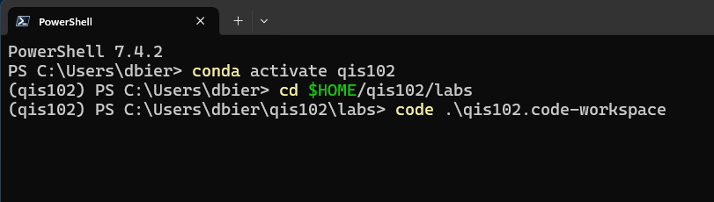
Microsoft Windows – Phase 3
After Phase 2 is completed, execute these three commands
(one line at a time):
conda activate qis102
cd $HOME/qis102/labs
code .\qis102.code-workspace
①
②
③

Slide 11
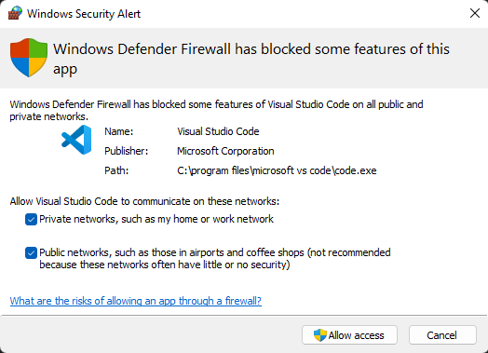
Microsoft Windows – Phase 3
If prompted, also select Private networks and
then click "Allow access"

Slide 12
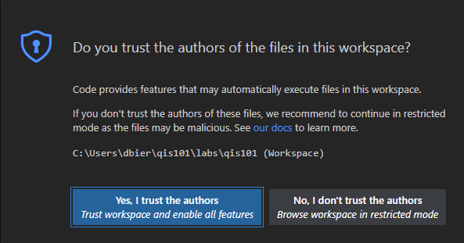
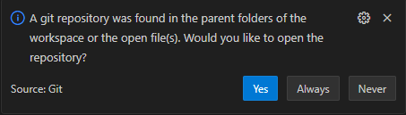
Microsoft Windows – Phase 3
If prompted, select "Yes, I trust the authors"
If prompted, select “Always"

Slide 13
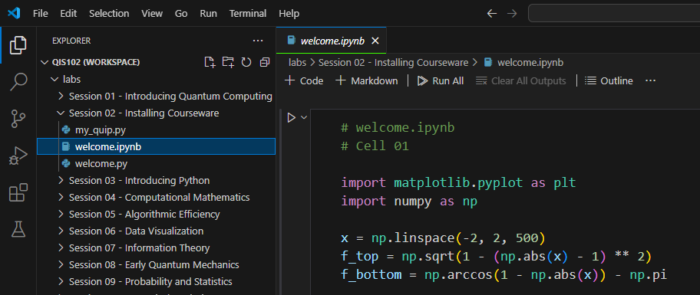
Microsoft Windows – Phase 3
Run Cell 01 in the welcome.ipynb file

Slide 14
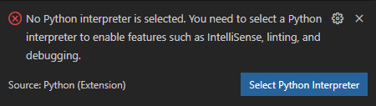
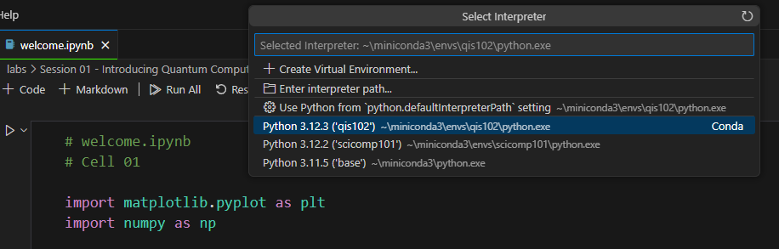
Microsoft Windows – Phase 3
If prompted, in the bottom right of the VS Code window,
click the "Select Python Interpreter" button

Slide 15
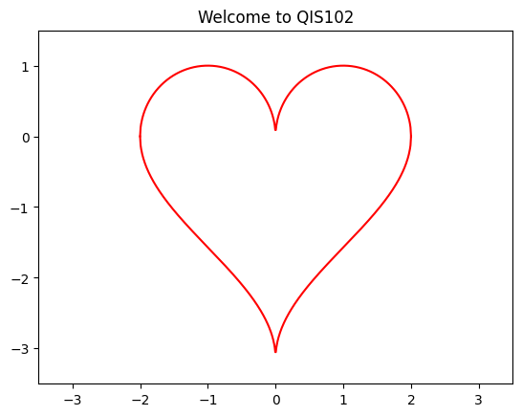
Microsoft Windows – Phase 3
Run Cell 01 in the welcome.ipynb file

Slide 16
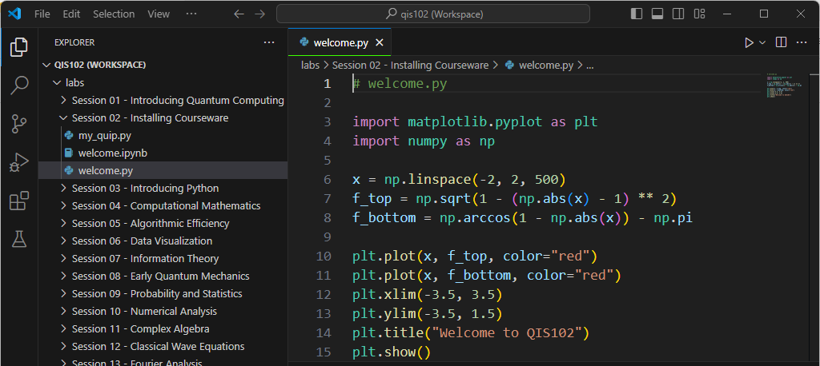
Microsoft Windows – Phase 3
Run welcome.py file

Slide 17
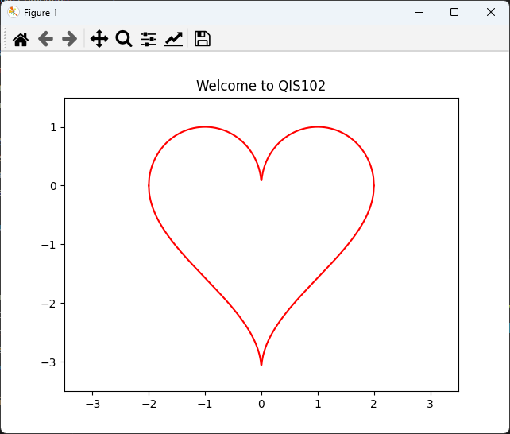
Microsoft Windows – Phase 3

Slide 18
Apple macOS – Phase 1
You must be running 64-bit macOS 11 (or later) with a minimum of 10GB of free disk space
Step 1 – Install Git - https://git-scm.com/download/mac using the homebrew install method for Git
Step 2 – Install Miniconda3 for macOS – first read this https://conda.io/projects/conda/en/latest/user-guide/install/macos.html and then do this (see next three slides)
If using an Intel CPU: download the script Miniconda3 MacOSX 64-bit bash https://repo.anaconda.com/miniconda/Miniconda3-latest-MacOSX-x86_64.sh
If using an M1 CPU: download the script Miniconda3 macOS Apple ARM bash https://repo.anaconda.com/miniconda/Miniconda3-latest-MacOSX-arm64.sh
There is also a homebrew recipe Git & Miniconda:
brew install git
brew install --cask miniconda

Slide 19
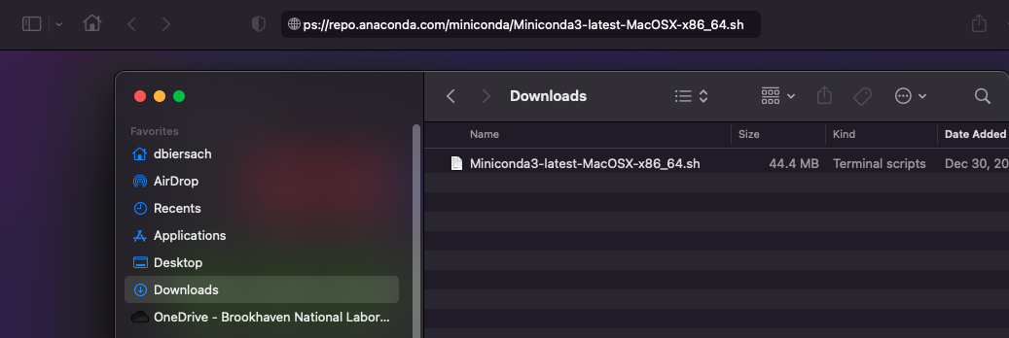
Apple macOS – Phase 1
After clicking on the appropriate script hyperlink in the prior slide (Phase 1 step #2a or #2b based upon your CPU type) your browser will place the script in your Downloads folder

Slide 20
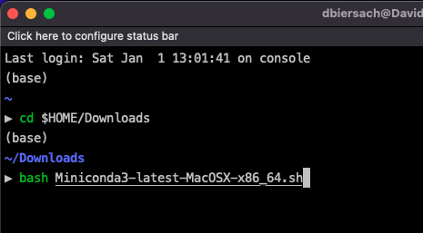
Apple macOS – Phase 1
To run the Miniconda install script that you downloaded,
open a new zsh (iTerm2) session, and execute these two commands:
cd $HOME/Downloads
bash Miniconda3-latest-MacOSX-x86_64.sh (if using an Intel CPU)
or
cd $HOME/Downloads
bash Miniconda3-latest-MacOSX-arm64.sh (if using an Apple ARM CPU)
①
②

Slide 21
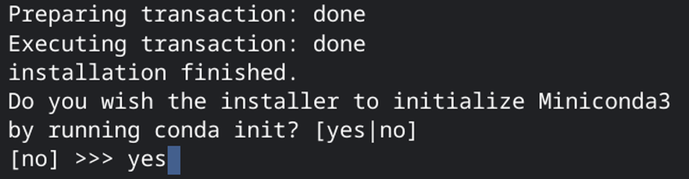
Apple macOS – Phase 1
When prompted as part of the Miniconda3 installer program, enter yes to initialize Miniconda3:

Slide 22
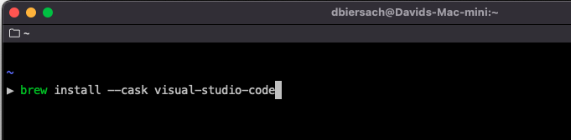
Apple macOS – Phase 1
Step 3 – Install Microsoft Visual Studio Code by executing this command: brew install --cask visual-studio-code

Slide 23
Apple macOS – Phase 2
After Phase 1 is completed, close that zsh window, and then
start a new zsh (iTerm2) session and execute these three commands:
cd $HOME
git clone https://github.com/dbiersach/qis102
source qis102/installers/qis102-install-mac.sh
Note: If the install script tries to run conda update and your computer says it cannot find 'conda'…
First, open a zsh session and change the working directory to the location of the conda executable on your filesystem. On macOS it is usually found in $HOME/opt/miniconda3/condabin
Then enter the following command: conda init zsh
Then close that zsh session and restart Phase 2 on this slide

Slide 24
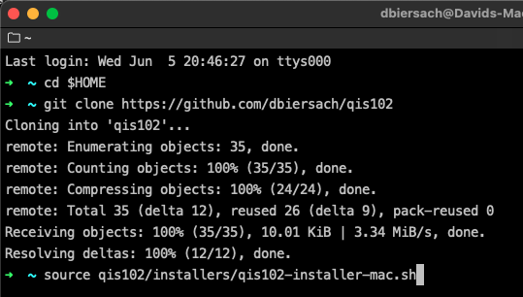
Apple macOS – Phase 2
Your screen might not look exactly like this
①
②
③

Slide 25
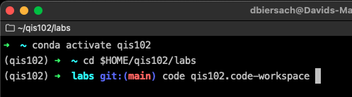
Apple macOS – Phase 3
After Phase 2 is completed,
execute these three commands (one line at a time):
conda activate qis102
cd $HOME/qis102/labs
code qis102.code-workspace
①
②
③

Slide 26
Apple macOS – Phase 3
If prompted, select "Yes, I trust the authors"
If prompted, select “Always"

Slide 27
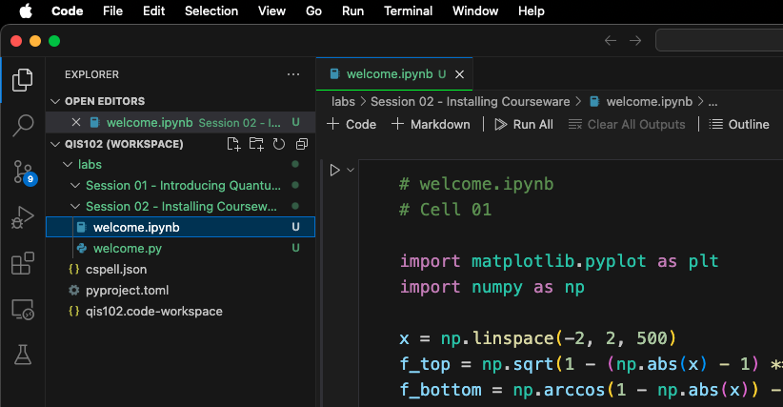
Apple macOS – Phase 3
Run Cell 01 in the welcome.ipynb file

Slide 28
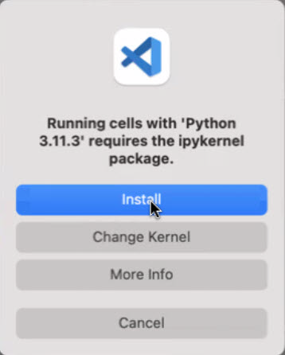
Apple macOS – Phase 3
If requested, install the ipykernel package

Slide 29
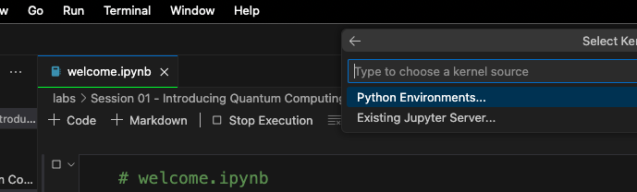
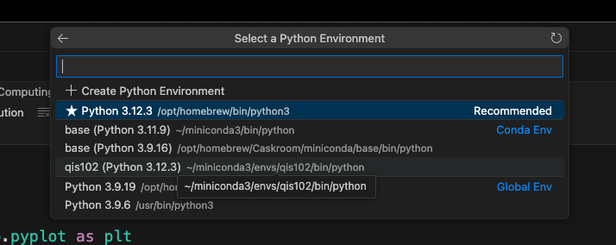
Apple macOS – Phase 3
If requested, select the qis102 Python Environment

Slide 30
Apple macOS – Phase 3
Run Cell 01 in the welcome.ipynb file

Slide 31
Apple macOS – Phase 3

Slide 32
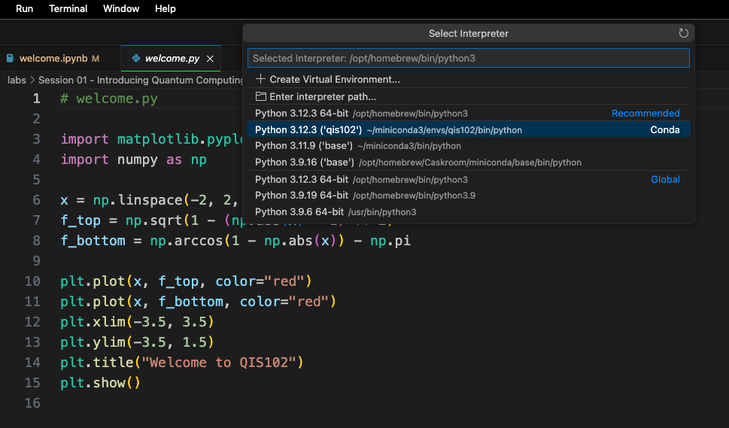
Apple macOS – Phase 3
If requested, select the qis102 Python Environment

Slide 33
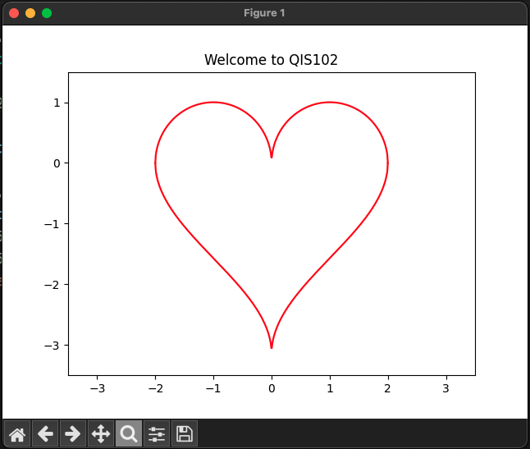
Apple macOS – Phase 3

Slide 34
Debian Linux – Phase 1
You must be running a 64-bit Debian-based Linux with a minimum of 10GB of free disk space
Step 1 – Install Git - https://git-scm.com/book/en/v2/Getting-Started-Installing-Git (I recommend installing via sudo apt install git-all)
Step 2 – Run sudo apt install libxcb-cursor0 (Note: needed for PyQt6)
Step 3 – Install Miniconda3 for Linux - read this first: https://docs.conda.io/projects/conda/en/latest/user-guide/install/linux.html - then do this (see next two slides)
If on an Intel PC: download the script Miniconda3 Linux 64-bit https://repo.anaconda.com/miniconda/Miniconda3-latest-Linux-x86_64.sh
If on an ARM PC: download the script Miniconda3 Linux-aarch64 64-bit https://repo.anaconda.com/miniconda/Miniconda3-latest-Linux-aarch64.sh

Slide 35
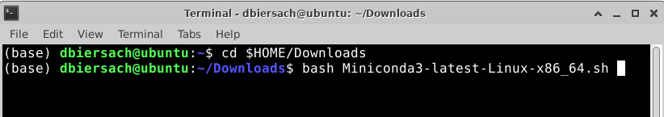
Debian Linux – Phase 1
To run the Miniconda install script that you downloaded,
open a new Terminal session, and execute these two commands
cd $HOME/Downloads
bash Miniconda3-latest-Linux-x86_64.sh
or
cd $HOME/Downloads
bash Miniconda3-latest-Linux-aarch64.sh
①
②

Slide 36
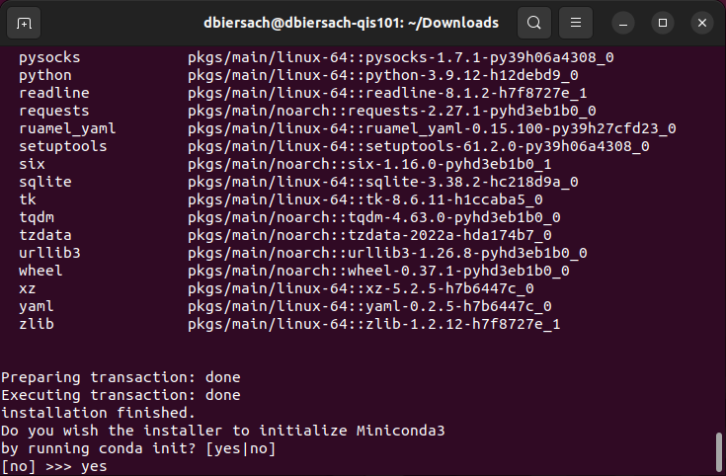
Debian Linux – Phase 1
When prompted "Do you wish the installer to initialize Miniconda3 by running conda init? [yes|no]" enter yes
①

Slide 37
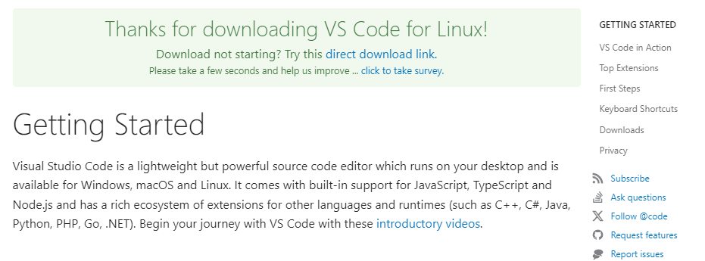
Debian Linux – Phase 1
Step 4 – Install Microsoft Visual Studio code using apt install or download directly from Microsoft: https://code.visualstudio.com/docs/?dv=linux64_deb

Slide 38
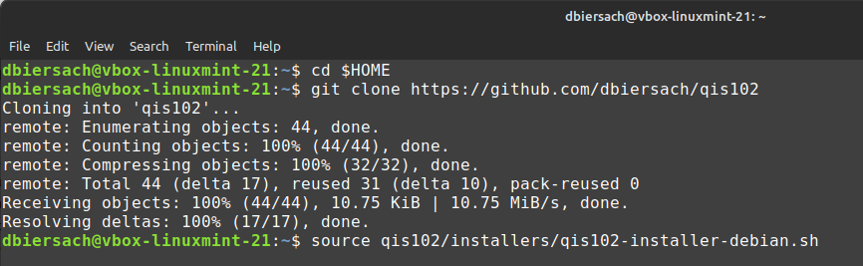
Debian Linux – Phase 2
After Phase 1 is completed, close that terminal window, and then
start a Terminal session and execute these three commands:
cd $HOME
git clone https://github.com/dbiersach/qis102
source qis102/installers/qis102-installer-debian.sh
Your screen might not look exactly like this
①
②
③

Slide 39
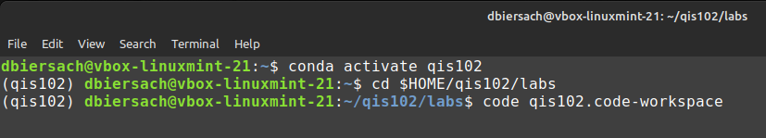
Debian Linux – Phase 3
After Phase 2 is completed, execute these three commands
(one line at a time):
conda activate qis102
cd $HOME/qis102/labs
code qis102.code-workspace
①
②
③

Slide 40
Debian Linux – Phase 3
If prompted, select "Yes, I trust the authors"
If prompted, select “Always"

Slide 41
Debian Linux – Phase 3
Run Cell 01 in the welcome.ipynb file

Slide 42
Debian Linux – Phase 3
If prompted, in the bottom right of the VS Code window,
click the "Select Python Interpreter" button

Slide 43
Debian Linux – Phase 3
Run Cell 01 in the welcome.ipynb file

Slide 44
Debian Linux – Phase 3
Run welcome.py file

Slide 45
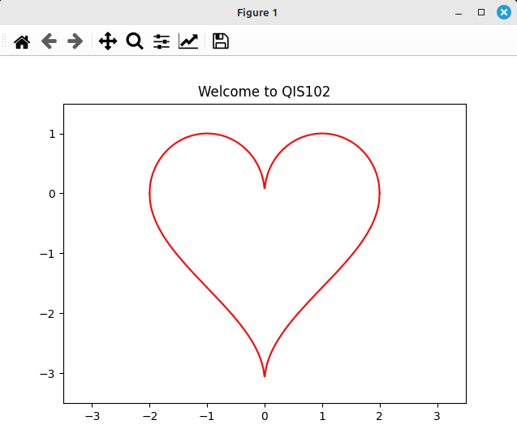
Debian Linux – Phase 3

Slide 46
TASK 02-01
Edit my_quip.py using Visual Studio Code to display your name and a witty short phrase
Upload your edited my_quip.py file to your personal folder on the BNL QIS102 SharePoint site
Please do not:
Change the file name – leave it my_quip.py
Upload a “my_quip" file that does not contain the .py file extension
Upload a screenshot of your my_quip.py output – always upload your actual Python source code file itself
Upload an edited welcome.py file

